Slide 1
Lecture 1
McGraw-Hill/Irwin
Copyright © 2010 by the McGraw-Hill Companies, Inc. All rights reserved.

Slide 2
Key Concepts and Skills
Know the basic types of financial management decisions and the role of the Financial Manager
Know the financial implications of the various forms of business organization
Know the goal of financial management
Understand the conflicts of interest that can arise between owners and managers

Slide 3
1.1 What Is Corporate Finance?
Corporate Finance addresses the following three questions:
  What long-term investments should the firm choose?
  How should the firm raise funds for the selected investments?
  How should short-term assets be managed and financed?

Slide 4
Balance Sheet Model of the Firm
  Total Value of Assets:
  Total Firm Value to Investors:
Current Assets
Current Liabilities
Long-Term Debt
Fixed Assets
1 Tangible
2 Intangible
Shareholders’ Equity
Notes:
It is sometimes helpful to relate corporate decisions to individual circumstances. For example, consider discussing how individuals choose to buy cars or homes and how this decision would affect a personal balance sheet.

Slide 5
The Capital Budgeting Decision
Current Assets
Current Liabilities
Long-Term Debt
Fixed Assets
1 Tangible
2 Intangible
  What long-term investments should the firm choose?
Shareholders’ Equity

Slide 6
The Capital Structure Decision
Current Assets
Current Liabilities
Long-Term Debt
How should the firm raise funds for the selected investments?
Fixed Assets
1 Tangible
2 Intangible
Shareholders’ Equity

Slide 7
Short-Term Asset Management
Current Assets
Current Liabilities
Net Working Capital
Long-Term Debt
  How should short-term assets be managed and financed?
Fixed Assets
1 Tangible
2 Intangible
Shareholders’ Equity

Slide 8
The Financial Manager
The Financial Manager’s primary goal is to increase the value of the firm by:
Selecting value creating projects
Making smart financing decisions
Notes:
Note, these actions explicitly relate to the three questions addressed in slide 3.

Slide 9
Hypothetical Organization Chart
Board of Directors
Chairman of the Board and
Chief Executive Officer (CEO)
President and Chief
Operating Officer (COO)
Vice President and
Chief Financial Officer (CFO)
Treasurer
Controller
Cash Manager
Credit Manager
Tax Manager
Cost Accounting
Capital Expenditures
Financial Planning
Financial Accounting
Data Processing

Slide 10
1.2 The Corporate Firm
The corporate form of business is the standard method for solving the problems encountered in raising large amounts of cash.
However, businesses can take other forms.

Slide 11
Forms of Business Organization
The Sole Proprietorship
The Partnership
  General Partnership
  Limited Partnership
The Corporation
  Private
  Public
  Companies with more than $10 million in assets whose securities are held by more than 500 owners must file annual and other periodic reports. These reports are available to the public through the SEC's EDGAR database.
  More info: http://www.sec.gov/about/laws.shtml
Notes:
It may be beneficial to discuss S-Corporations and LLCs in the context of this slide.

Slide 12
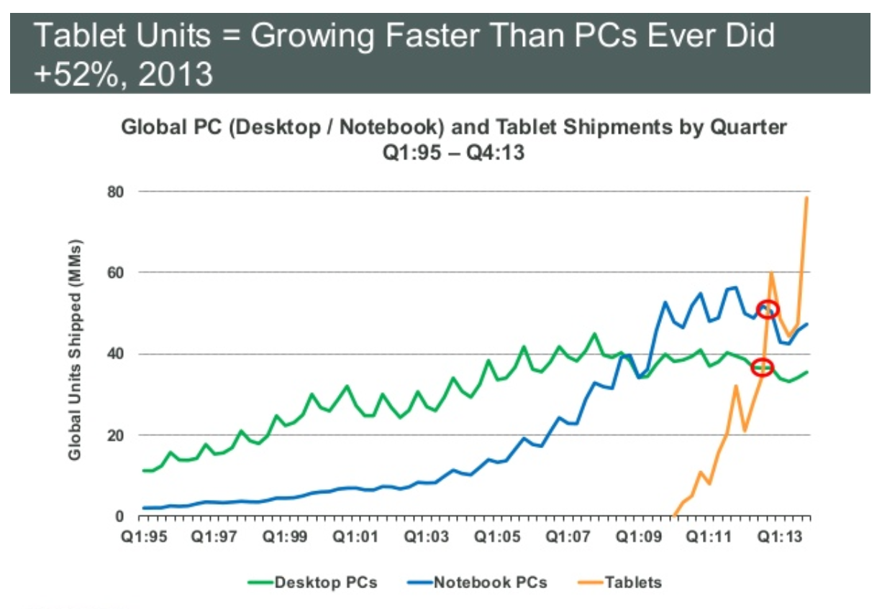
DELL

Slide 13
A Comparison
Corporation
Partnership
Liquidity
Shares can be easily exchanged
Subject to substantial restrictions
Voting Rights
Usually each share gets one vote
General Partner is in charge; limited partners may have some voting rights
Taxation
Double
Partners pay taxes on distributions
Reinvestment and dividend payout
Broad latitude
All net cash flow is distributed to partners
Liability
Limited liability
General partners may have unlimited liability; limited partners enjoy limited liability
Continuity
Perpetual life
Limited life

Slide 14
1.3 The Importance of Cash Flow
Firm issues securities (A)
Firm
Financial
markets
Invests
in assets
(B)
Retained
cash flows (F)
Cash flow
from firm (C)
Dividends and
debt payments (E)
Short-term debt
Long-term debt
Equity shares
Current assets
Fixed assets
Taxes (D)
The cash flows from the firm must exceed the cash flows from the financial markets.
Ultimately, the firm must be a cash generating activity.
Government
Notes:
It is important to remind students that net income is NOT cash flow.

Slide 15
1.4 The Goal of Financial Management
What is the correct goal?
  Maximize profit?
  Minimize costs?
  Maximize market share?
  Maximize shareholder wealth?

Slide 16
1.5 The Agency Problem
Agency relationship
  Principal hires an agent to represent his/her interest
  Stockholders (principals) hire managers (agents) to run the company
Agency problem
  Conflict of interest between principal and agent
Notes:
A common example of an agency relationship is a real estate broker – in particular if you break it down between a buyers agent and a sellers agent. A classic conflict of interest is when the agent is paid on commission, so they may be less willing to let the buyer know that a lower price might be accepted or they may elect to only show the buyer homes that are listed at the high end of the buyer’s price range.
Direct agency costs – the purchase of something for management that can’t be justified from a risk-return standpoint, monitoring costs.
Indirect agency costs – management’s tendency to forgo risky or expensive projects that could be justified from a risk-return standpoint.

Slide 17
Managerial Goals
Managerial goals may be different from shareholder goals
  Expensive perquisites
  Survival
  Independence
Increased growth and size are not necessarily equivalent to increased shareholder wealth

Slide 18
Managing Managers
Managerial compensation
  Incentives can be used to align management and stockholder interests
  The incentives need to be structured carefully to make sure that they achieve their intended goal
Corporate control
  The threat of a takeover may result in better management
Other stakeholders
Notes:
Incentives – discuss how incentives must be carefully structured. For example, tying bonuses to profits might encourage management to pursue short-run profits and forego projects that require a large initial outlay. Stock options may work, but there may be an optimal level of insider ownership. Beyond that level, management may be in too much control and may not act in the best interest of all stockholders. The type of stock can also affect the effectiveness of the incentive.
Corporate control – ask the students why the threat of a takeover might make managers work towards the goals of stockholders.
Other groups also have a financial stake in the firm. They can provide a valuable monitoring tool, but they can also try to force the firm to do things that are not in the owners’ best interest.

Slide 19
Quick Quiz
What are the three basic questions Financial Managers must answer?
What are the three major forms of business organization?
What is the goal of financial management?
What are agency problems, and why do they exist within a corporation?

Slide 20
2.1 The Balance Sheet
An accountant’s snapshot of the firm’s accounting value at a specific point in time
The Balance Sheet Identity is:
Assets ≡ Liabilities + Stockholder’s Equity
Notes:
Note that Slides 4 through 7 from Chapter 1 could be reused here to emphasize the general structure of the balance sheet.
The left-hand side of the balance sheet lists the assets of the firm. Current assets are listed first because they are the most liquid. Fixed assets can include both tangible and intangible assets, and they are listed at the bottom because they generally are not very liquid. These are a direct result of management’s investment decisions. (Please emphasize that “investment decisions” are not limited to investments in financial assets.)
Note that the balance sheet does not list some very valuable assets, such as the people who work for the firm.
The liabilities and equity (or ownership) components of the firm are listed on the right-hand side. This indicates how the assets are paid for. Since the balance sheet has to balance, total equity = total assets – total liabilities. The portion of equity that can most easily fluctuate to create this balance is retained earnings. The right-hand side of the balance sheet is a direct result of management’s financing decisions.
Remember that shareholders’ equity consists of several components, and that total equity includes all of these components not just the “common stock” item. In particular, remind students that retained earnings belong to the shareholders.

Slide 21
U.S. Composite Corporation Balance Sheet
The assets are listed in order by the length of time it would normally take a firm with ongoing operations to convert them into cash.
Clearly, cash is much more liquid than property, plant, and equipment.
2010
2009
2010
2009
Current assets:
Current Liabilities:
Cash and equivalents
$140
$107
Accounts payable
$213
$197
Accounts receivable
294
270
Notes payable
50
53
Inventories
269
280
Accrued expenses
223
205
Other
58
50
Total current liabilities
$486
$455
Total current assets
$761
$707
Long-term liabilities:
Fixed assets:
Deferred taxes
$117
$104
Property, plant, and equipment
$1,423
$1,274
Long-term debt
471
458
Less accumulated depreciation
(550)
(460)
Total long-term liabilities
$588
$562
Net property, plant, and equipment
873
814
Intangible assets and other
245
221
Stockholder's equity:
Total fixed assets
$1,118
$1,035
Preferred stock
$39
$39
Common stock ($1 par value)
55
32
Capital surplus
347
327
Accumulated retained earnings
390
347
Less treasury stock
(26)
(20)
Total equity
$805
$725
Total assets
$1,879
$1,742
Total liabilities and stockholder's equity
$1,879
$1,742

Slide 22
Balance Sheet Analysis
When analyzing a balance sheet, the Finance Manager should be aware of three concerns:
    Liquidity
    Debt versus equity
    Value versus cost

Slide 23
Liquidity
Refers to the ease and quickness with which assets can be converted to cash—without a significant loss in value
Current assets are the most liquid.
Some fixed assets are intangible.
The more liquid a firm’s assets, the less likely the firm is to experience problems meeting short-term obligations.
Liquid assets frequently have lower rates of return than fixed assets.
Notes:
Liquidity is a very important concept. Students tend to remember the “convert to cash quickly” component of liquidity, but often forget the part about “without loss of value.” Remind them that we can convert anything to cash quickly if we are willing to lower the price enough, but that doesn’t mean it is liquid.
Also, point out that a firm can be TOO liquid. Excess cash holdings lead to overall lower returns. See the IM for a more complete discussion of this issue.

Slide 24
Debt versus Equity
Creditors generally receive the first claim on the firm’s cash flow.
Shareholder’s equity is the residual difference between assets and liabilities.

Slide 25
Value versus Cost
Under Generally Accepted Accounting Principles (GAAP), audited financial statements of firms in the U.S. carry assets at cost.
Market value is the price at which the assets, liabilities, and equity could actually be bought or sold, which is a completely different concept from historical cost.

Slide 26
2.2 The Income Statement
Measures financial performance over a specific period of time
The accounting definition of income is:
Revenue – Expenses ≡ Income

Slide 27
U.S.C.C. Income Statement
The operations section of the income statement reports the firm’s revenues and expenses from principal operations.
Total operating revenues
$2,262
Cost of goods sold
1,655
Selling, general, and administrative expenses
327
Depreciation
90
Operating income
$190
Other income
29
Earnings before interest and taxes
$219
Interest expense
49
Pretax income
$170
Taxes
84
Current: $71
Deferred: $13
Net income
$86
Addition to retained earnings $43
Dividends: $43

Slide 28
U.S.C.C. Income Statement
The non-operating section of the income statement includes all financing costs, such as interest expense.
Total operating revenues
$2,262
Cost of goods sold
1,655
Selling, general, and administrative expenses
327
Depreciation
90
Operating income
$190
Other income
29
Earnings before interest and taxes
$219
Interest expense
49
Pretax income
$170
Taxes
84
Current: $71
Deferred: $13
Net income
$86
Addition to retained earnings: $43
Dividends: $43

Slide 29
U.S.C.C. Income Statement
Total operating revenues
$2,262
Cost of goods sold
1,655
Selling, general, and administrative expenses
327
Depreciation
90
Operating income
$190
Other income
29
Usually a separate section reports the amount of taxes levied on income.
Earnings before interest and taxes
$219
Interest expense
49
Pretax income
$170
Taxes
84
Current: $71
Deferred: $13
Net income
$86
Addition to retained earnings: $43
Dividends: $43

Slide 30
U.S.C.C. Income Statement
Total operating revenues
$2,262
Cost of goods sold
1,655
Selling, general, and administrative expenses
327
Depreciation
90
Operating income
$190
Other income
29
Earnings before interest and taxes
$219
Net income is the “bottom line.”
Interest expense
49
Pretax income
$170
Taxes
84
Current: $71
Deferred: $13
Net income
$86
Retained earnings: $43
Dividends: $43

Slide 31
Income Statement Analysis
There are three things to keep in mind when analyzing an income statement:
  Generally Accepted Accounting Principles (GAAP)
  Non-Cash Items
  Time and Costs

Slide 32
GAAP
The matching principle of GAAP dictates that revenues be matched with expenses.
Thus, income is reported when it is earned, even though no cash flow may have occurred.

Slide 33
Non-Cash Items
Depreciation is the most apparent. No firm ever writes a check for “depreciation.”
Another non-cash item is deferred taxes, which does not represent a cash flow.
Thus, net income is not cash.

Slide 34
Time and Costs
In the short-run, certain equipment, resources, and commitments of the firm are fixed, but the firm can vary such inputs as labor and raw materials.
In the long-run, all inputs of production (and hence costs) are variable.
Financial accountants do not distinguish between variable costs and fixed costs. Instead, accounting costs usually fit into a classification that distinguishes product costs from period costs.

Slide 35

2.3 Taxes
The one thing we can rely on with taxes is that they are always changing
Marginal vs. average tax rates
  Marginal – the percentage paid on the next dollar earned
  Average – the tax bill / taxable income
Other taxes
Notes:
Point out that taxes can be a very important component of the decision making process, but that what they learn about tax specifics now could change tomorrow. Consequently, it is important to keep up with the changing tax laws and to utilize specialists in the tax area when making decisions where taxes are involved.
www: Click on the web surfer icon to go to the IRS web site for the most up-to-date tax information.
It is important to point out that we are concerned with the taxes that we will pay if a decision is made. Consequently, the marginal tax rate is what we should use in our analysis.
Point out that the tax rates discussed in the book are just federal taxes. Many states and cities have income taxes as well, and those taxes should figure into any analysis that we conduct.

Slide 36
Marginal versus Average Rates
Suppose your firm earns $4 million in taxable income.
  What is the firm’s tax liability?
  What is the average tax rate?
  What is the marginal tax rate?
If you are considering a project that will increase the firm’s taxable income by $1 million, what tax rate should you use in your analysis?
Notes:
Tax liability:
.15(50,000) + .25(75,000 – 50,000) + .34(100,000 – 75,000) + .39(335,000 – 100,000) + .34(4,000,000 – 335,000) = $1,360,000
Average rate: 1,360,000 / 4,000,000 = .34 or 34%
Marginal rate comes from the table, and it is 34%
We should use the marginal rate with an expected additional $340,000 in taxes.

Slide 37
2.4 Net Working Capital
Net Working Capital ≡
Current Assets – Current Liabilities
NWC usually grows with the firm

Slide 38
U.S.C.C. Balance Sheet
$252m = $707- $455
2010
2009
2010
2009
Current assets:
Current Liabilities:
Cash and equivalents
$140
$107
Accounts payable
$213
$197
Accounts receivable
294
270
Notes payable
50
53
Inventories
269
280
Accrued expenses
223
205
Other
58
50
Total current liabilities
$486
$455
Total current assets
$761
$707
Long-term liabilities:
Here we see NWC grow to $275 million in 2010 from $252 million in 2009.
Fixed assets:
Deferred taxes
$117
$104
Property, plant, and equipment
$1,423
$1,274
Long-term debt
471
458
Less accumulated depreciation
(550)
(460
Total long-term liabilities
$588
$562
Net property, plant, and equipment
873
814
Intangible assets and other
245
221
Stockholder's equity:
Total fixed assets
$1,118
$1,035
$23 million
Preferred stock
$39
$39
Common stock ($1 par value)
55
32
$275m = $761m- $486m
Capital surplus
347
327
This increase of $23 million is an investment of the firm.
Accumulated retained earnings
390
347
Less treasury stock
(26)
(20)
Total equity
$805
$725
Total assets
$1,879
$1,742
Total liabilities and stockholder's equity
$1,879
$1,742

Slide 39
2.5 Financial Cash Flow
In finance, the most important item that can be extracted from financial statements is the actual cash flow of the firm.
Since there is no magic in finance, it must be the case that the cash flow received from the firm’s assets must equal the cash flows to the firm’s creditors and stockholders.
CF(A)≡ CF(B) + CF(S)
Notes:
Remind students that this relation is just an application of the standard balance sheet identity.

Slide 40
U.S.C.C. Financial Cash Flow
Cash Flow of the Firm
Operating Cash Flow:
EBIT $219
Depreciation $90
Current Taxes -$71
OCF $238
Operating cash flow
$238
(Earnings before interest and taxes
plus depreciation minus taxes)
Capital spending
-173
(Acquisitions of fixed assets
minus sales of fixed assets)
Additions to net working capital
-23
Total
$42
Cash Flow of Investors in the Firm
Debt
$36
(Interest plus retirement of debt
minus long-term debt financing)
Equity
6
(Dividends plus repurchase of
equity minus new equity financing)
Total
$42

Slide 41
U.S.C.C. Financial Cash Flow
Cash Flow of the Firm
Operating cash flow
$238
(Earnings before interest and taxes
Capital Spending
Purchase of fixed assets $198
Sales of fixed assets -$25
Capital Spending $173
plus depreciation minus taxes)
Capital spending
-173
(Acquisitions of fixed assets
minus sales of fixed assets)
Additions to net working capital
-23
Total
$42
Cash Flow of Investors in the Firm
Debt
$36
(Interest plus retirement of debt
minus long-term debt financing)
Equity
6
(Dividends plus repurchase of
equity minus new equity financing)
Total
$42
Notes:
Note that capital spending can also be calculated as:
End NFA – Beg NFA + Depr
= $1,118 - $1,035 + $90 = $173

Slide 42
U.S.C.C. Financial Cash Flow
Cash Flow of the Firm
Operating cash flow
$238
(Earnings before interest and taxes
NWC grew from $275 million in 2010 from $252 million in 2009.
This increase of $23 million is the addition to NWC.
plus depreciation minus taxes)
Capital spending
-173
(Acquisitions of fixed assets
minus sales of fixed assets)
Additions to net working capital
-23
Total
$42
Cash Flow of Investors in the Firm
Debt
$36
(Interest plus retirement of debt
minus long-term debt financing)
Equity
6
(Dividends plus repurchase of
equity minus new equity financing)
Total
$42

Slide 43
U.S.C.C. Financial Cash Flow
Cash Flow of the Firm
Operating cash flow
$238
(Earnings before interest and taxes
plus depreciation minus taxes)
Capital spending
-173
(Acquisitions of fixed assets
minus sales of fixed assets)
Additions to net working capital
-23
Total
$42
Cash Flow of Investors in the Firm
Debt
$36
(Interest plus retirement of debt
minus long-term debt financing)
Equity
6
(Dividends plus repurchase of
equity minus new equity financing)
Total
$42

Slide 44
U.S.C.C. Financial Cash Flow
Cash Flow of the Firm
Operating cash flow
$238
(Earnings before interest and taxes
Cash Flow to Creditors
Interest $49
Retirement of debt 73
Debt service 122
Proceeds from new debt sales -86
Total $36
plus depreciation minus taxes)
Capital spending
-173
(Acquisitions of fixed assets
minus sales of fixed assets)
Additions to net working capital
-23
Total
$42
Cash Flow of Investors in the Firm
Debt
$36
(Interest plus retirement of debt
minus long-term debt financing)
Equity
6
(Dividends plus repurchase of
equity minus new equity financing)
Total
$42
Notes:
Cash flow to creditors can also be calculated as:
Interest paid – Net new borrowing = Interest paid – (End LT Debt – Beg LT Debt)
=$49 – ($471 - $458) = $36

Slide 45
U.S.C.C. Financial Cash Flow
Cash Flow of the Firm
Operating cash flow
$238
(Earnings before interest and taxes
Cash Flow to Stockholders
Dividends $43
Repurchase of stock 6
Cash to Stockholders 49
Proceeds from new stock issue -43
Total $6
plus depreciation minus taxes)
Capital spending
-173
(Acquisitions of fixed assets
minus sales of fixed assets)
Additions to net working capital
-23
Total
$42
Cash Flow of Investors in the Firm
Debt
$36
(Interest plus retirement of debt
minus long-term debt financing)
Equity
6
(Dividends plus repurchase of
equity minus new equity financing)
Total
$42

Slide 46
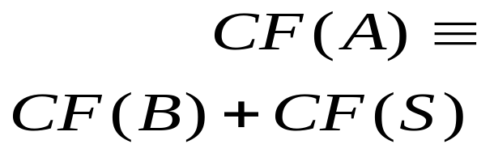
U.S.C.C. Financial Cash Flow
Cash Flow of the Firm
The cash flow received from the firm’s assets must equal the cash flows to the firm’s creditors and stockholders:
Operating cash flow
$238
(Earnings before interest and taxes
plus depreciation minus taxes)
Capital spending
-173
(Acquisitions of fixed assets
minus sales of fixed assets)
Additions to net working capital
-23
Total
$42
Cash Flow of Investors in the Firm
Debt
$36
(Interest plus retirement of debt
minus long-term debt financing)
Equity
6
(Dividends plus repurchase of
equity minus new equity financing)
Total
$42

Slide 47
2.7 Cash Flow Management
Earnings can be manipulated using subjective decisions required under GAAP
Total cash flow is more objective, but the underlying components may also be “managed”
  Moving cash flow from the investing section to the operating section may make the firm’s business appear more stable

Slide 48
Quick Quiz
What is the difference between book value and market value? Which should we use for decision making purposes?
What is the difference between accounting income and cash flow? Which do we need to use when making decisions?
What is the difference between average and marginal tax rates? Which should we use when making financial decisions?
How do we determine a firm’s cash flows? What are the equations, and where do we find the information?

